Slide 1

Normalization in SQL
(SQL)

Slide 2
Normalization
In a database, normalization helps to organize the data so that it is easy to find and use.
It is like organizing your toys and games into different boxes or containers.

Slide 3
Types of Normalization
Second Normal Form (2NF)
Third Normal Form (3NF)
Boyce-Codd Normal Form (BCNF) or 3.5
First Normal Form (1NF)

Slide 4
First Normal form (1NF)
First Normal Form (1NF) is like putting all your toys in separate boxes.

Slide 5
First Normal form (1NF)
First Normal Form (1NF) is like putting all your toys in separate boxes.
Each box only has one type of toy, and you can easily find the toy you want without having to look through a lot of different things.

Slide 6
First Normal form (1NF)
First Normal Form (1NF) is like putting all your toys in separate boxes.
Each box only has one type of toy, and you can easily find the toy you want without having to look through a lot of different things.
A database is in first normal form if it satisfies the following conditions:
Contains only atomic values
There are no repeating groups

Slide 7
Example of 1st Normal form
Product ID | Name | Price
1 | Asus | 20,000
2 | Hp, Lenovo | 30,000
3 | Dell | 50,000
Product ID | Name
1 | Asus
2 | Hp
2 | Lenovo
3 | Dell
Product ID | Price
1 | 20,000
2 | 30,000
3 | 50,000

Slide 8
Second Normal Form (2NF)
Imagine you have a toy box where you keep all your toys. To keep your toys organized, you decide to put similar toys together, like all your cars in one spot, all your dolls in another spot, and so on. This is like the first normal form in a database.

Slide 9
Second Normal Form (2NF)
Imagine you have a toy box where you keep all your toys. To keep your toys organized, you decide to put similar toys together, like all your cars in one spot, all your dolls in another spot, and so on. This is like the first normal form in a database.
Now, imagine you have a special toy that has different parts, like a car with wheels, doors, and a roof. To make sure you can find all the parts easily, you decide to put the wheels, doors, and roof in separate compartments within the same toy box. This is like the second normal form in a database.

Slide 10
Second Normal Form (2NF)
In 2NF, a table must meet the following two conditions:
It must be in First Normal Form (1NF),
It must not have any partial dependencies

Slide 11
Second Normal Form (2NF)
It must be in First Normal Form (1NF),
It must not have any partial dependencies
A partial dependency occurs when a non-primary key column depends on only a part of a primary key.

Slide 12
Questions
This is functional dependence equation
SID, RollNo -----Hour
SID ------Sname
Pname, Paddress-- Roll no
Check whether it is partial dependency or not, and if it is then how many tables needed to make it in second normal form

Slide 13
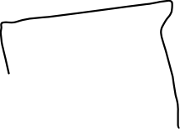


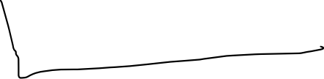

Create an arrow diagram
SID | Roll No | Hours | Sname | Pname | PAddress

Slide 14
SiD, Roll no ------ Prime attributes
Hour, Sname, Pname, Padress- Non prime attributes
Step 2- take closure
(SiD, Rollno)* = (SiD, Rollno, Hours,Sname, Pname, Paddress)
SID Roll no --- Candidate key
SID, RollNo -----Hours (Full dependent)
SID ------Sname (PD)
Roll No----- Pname, Paddress (PD)
SID | Roll No | Hours | Sname | Pname | PAddress

Slide 15
SID | Roll No | Hours | Sname | Pname | PAddress
SID
Roll No
Hours
SID | Roll no | Hours
Roll no | P Name | P Address
SID | ROLL no
SID | SNAME

Slide 16
You will give some functional dependence equation
Next identify the unique attributes and make it arrow diagram
Now identify the prime and non-prime
Next find the candidate key (it can derive all the variables)
Based on candidate key I will be finding which equation is fully dependency or partial dependency
Next we will use the functional dependence equation and (3 equation--- 3 tables + n table for n prime attributes)

Slide 17
Question
Pq----r
Ps---- vw
Qs-----tu
P-----x
W-----y
Check whether it is partial dependency or not, and if it is then how many tables needed to make it in second normal form

Slide 18

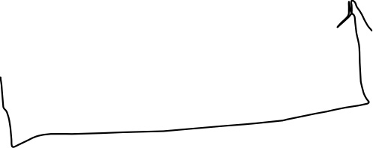
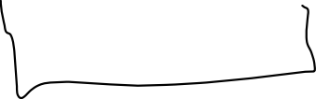

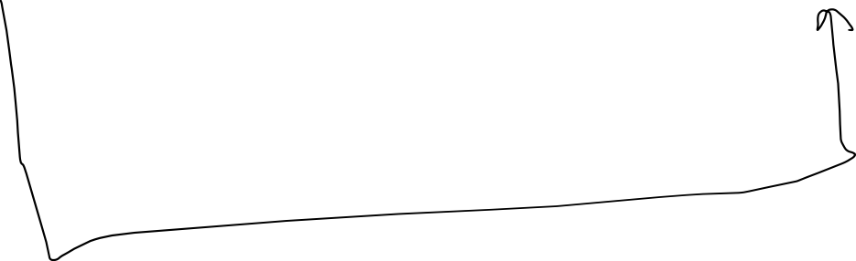





Prime attribute --- (pqs)*
Non prime---r,t,u,v,w,x,y
p | q | r | s | t | u | v | w | x | y

Slide 19
Prime--- p,q,s Non prime
p | q | r | s | t | u | v | w | x | y
Attributes
{P,q,r,s,t,u,v,w,x,y}
Pq----r (pd)
Ps---- vw (pd)
Qs-----tu (pd)
P-----x (pd)
W-----y (pd)
(pqs)*----- (pqsrvwtuxy)
p | s | v | w
p | q | r
q | s | t | u
p | x
w | y
p | q | s

Slide 20
Third Normal Form (3NF)
It must be in Second Normal Form (2NF),
It must not have any transitive dependencies.

Slide 21
Transitive dependency
X→y
X→z
Y→z

Slide 22
Third Normal Form (3NF)
It must be in Second Normal Form (2NF),
It must not have any transitive dependencies.

Slide 23
Third Normal Form (3NF)
It must be in Second Normal Form (2NF),
It must not have any transitive dependencies.
A transitive dependency occurs when a non-primary key column
depends on another non-primary key column.

Slide 24
Question
Function dependency (FD) equation
X→y
y→z
Check whether it is partial dependency and transitive dependency or not, and if it is then how many tables needed to make it in third normal form

Slide 25
x | y | z

Slide 26

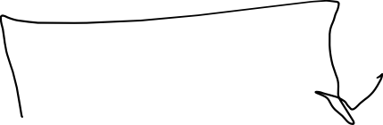
Prime- (x)*
Non prime- y and z
X | y | Z

Slide 27
Function dependency (FD)= X→y, y→z
Step 1- make an arrow diagram
X– prime
Y,z– non prime
Step 2- find the candidate key
(X)*--Xyz
No non prime attribute should be transitively dependent on candidate key
X | y | Z
y | Z
X | y

Slide 28
3rd normal form
X is a super key of R or
A is prime attribute of R
X→A

Slide 29
Step – Make the arrow diagram
Step 2- Identify the prime and non prime attributes
Step 3- find the candidate key
(start with prime)– if it is not a candidate key
Then go with the LHS of FD equation.
Step 4- X-----A (X is super key, or A is prime attribute)
Step 5- check with equation
Step 6- divide the table into (n+ prime one)

Slide 30
Boyce Codd Normal form
It must be in third Normal Form (3NF),
Every determinant is a candidate key.
A determinant is a column or set of columns that
determine the value of other columns in the table.

Slide 31
Question
FD equation
Xy---z
Z---y
Check whether it is in BCNF or not. If not, how many tables needed to make it in BCNF.

Slide 32



Example of BCNF
Fd
Xy---z (right)
Z---y (not in bcnf)
Prime—(x).
Non prime(yz)
(Xy)* ---- X,y,zx
y
(XZ)*--XZY
X-→A (X--- super key, A--- prime attributes)---- 3rd normal form
X→A (X--- super key)– 3.5 Normal formal
(X,y) and (y,z) is also a super key (super key can be a candidate key)
x | y | z
Z | Y
X | Z

Slide 33
1
1 nf
2nf
3rd
bcnf

Slide 34
Interview
First normal form (the value should be atomic in nature)
Second normal form (it does not contain any partial dependency)
(S--Z)--- it will not be in 2nd normal form
(X--y)--- X and Y must be independent from each other
Third normal form (it does not have any transitive dependency)
(X---→ A,,,X should be a super key or A is prime attribute)
BCNF or 3.5 (X should be a super key)

Slide 35
Total number of decompose table
When you decompose table (find the equation which does not satisfy your rule)
5 equation – 3 of them are not satisfying
So, the total number of decomposition will be (3+ no of prime key)

